Slide 1
Unified GPU Programming in Julia: Vendor Abstraction and High-Level Control with KernelAbstractions
Julian Samaroo
Rabab Alomairy
with material by Valentin Churavy

Slide 2

Outline
How to program a GPU
Vector Addition Example
Matrix Multiplication Example (CUDA C++ )
Matrix Multiplication Example (CUDA.jl, AMDGPU.jl, oneAPI.jl and Metal.jl)
Matrix Multiplication Example (KernelAbstractions.jl)
=> Goal: Performance portability — Single program mapped onto hardware with similar performance to native execution
Performance — Microbenchmark (Naive Matrix Multiplication (GEMM))
Memory copy with KernelAbstractions
Notes:
overview

Slide 3
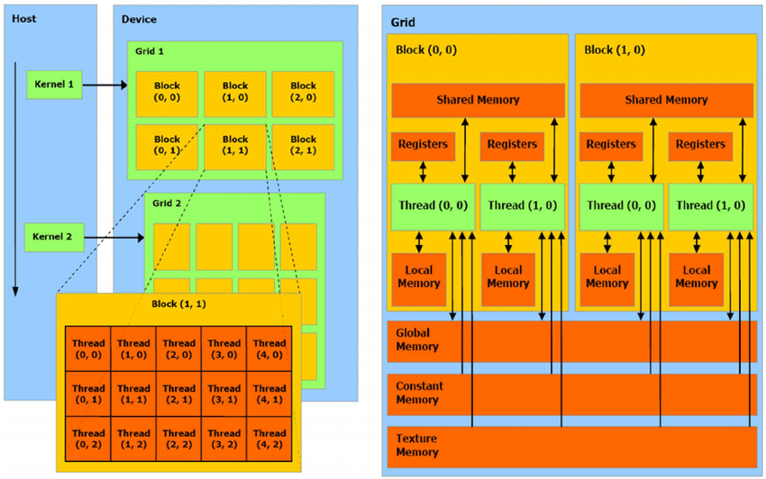
How to program a GPU
Single-Instruction-Multiple-Threads (SIMT).
SIMT is designed to allow GPUs to execute the same instruction across multiple threads
Programming perspective is a thread
Each thread executes the same code (kernel) but operates on different data
Threads are grouped into blocks/warps
Blocks can then be grouped into grids
Threads with block can access shared memory and synchronize as needed
GPUs are designed to maximize throughput.
Transferring data from the CPU to the GPU is a necessary step and can be a bottleneck

Slide 4
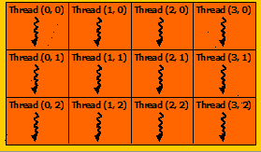
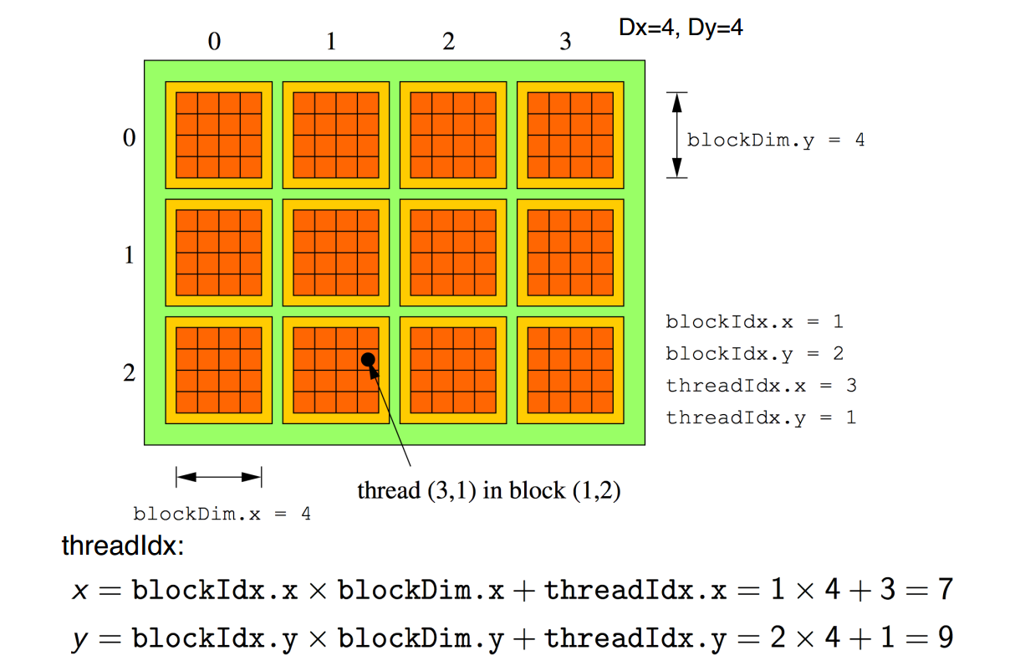
SIMT Programming model
The GPU programming model is structured hierarchically into three levels: threads, blocks, and grids
Efficient GPU programming involves managing these levels to maximize performance, memory usage, and communication among threads
The formula calculates the global thread ID by considering the position of the thread within its block , the position of the block within the grid, and block dimension.
Block
Grid
x
y

Slide 5
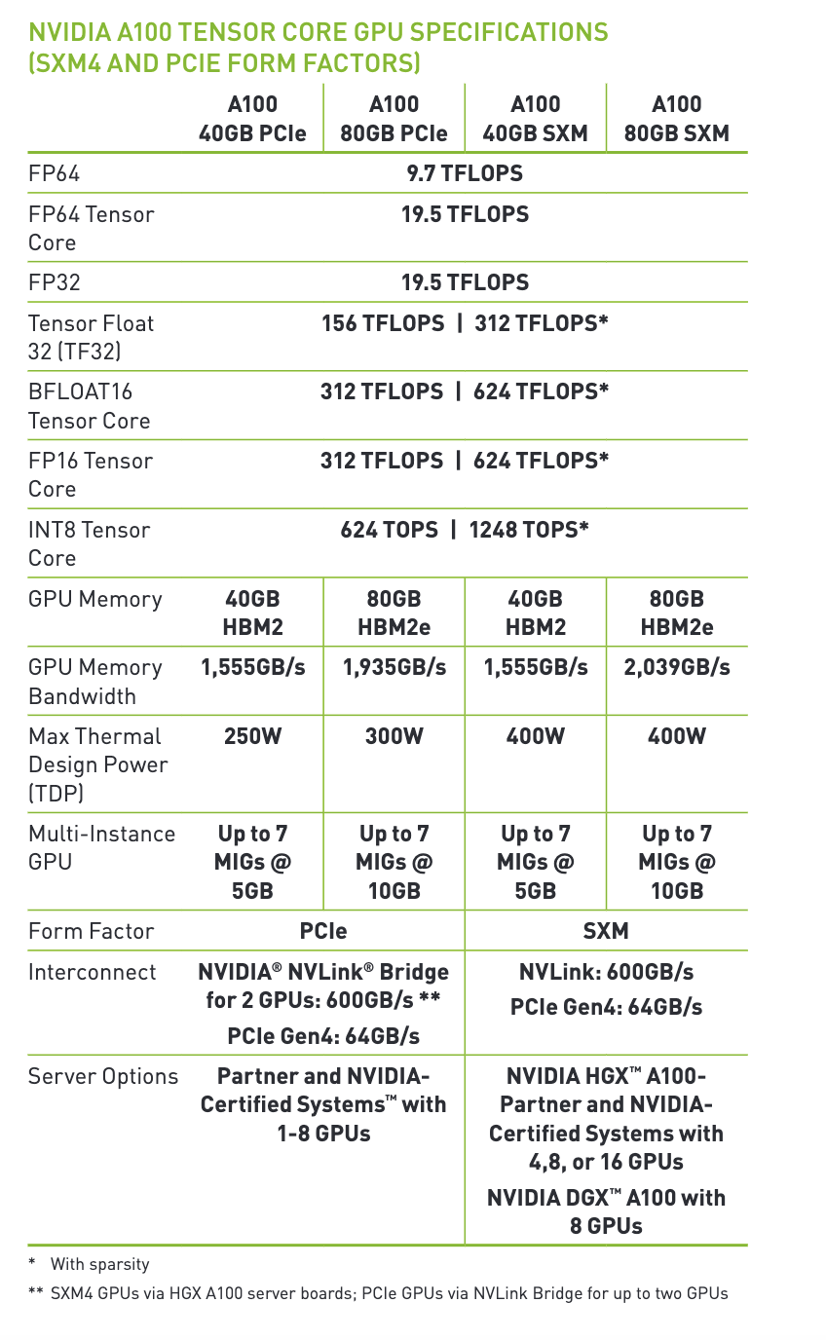
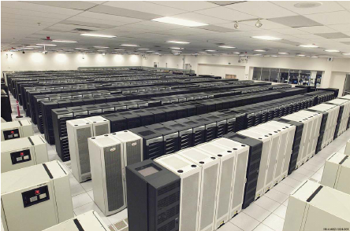
NVIDIA Ampere A100
An NVIDIA A100 GPU contains 108 Streaming Multiprocessors (SMs)
It has 40 MB L2 cache, which helps reduce latency
It supports up to 80 GB of HBM2 memory with a maximum memory bandwidth of 2039 GB/s , essential for handling large data and reducing data transfer.
It contains in total 6912 FP32/INT32 CUDA cores and 3456 FP64 CUDA cores
NVIDIA H100: offers up to 30 TFLOPs of FP64 performance, which is over 3x the FP64 performance of the A100
GB200 Grace Blackwell Superchip: Provides 90 TFLOPS of FP64 performance
ASCI White supercomputer
Lawrence Livermore National Laboratory
Top #1 in 2007, 7.9 TFLOPS

Slide 6
Vector Addition Example
CPU code
GPU (CUDA) kernel
vector_size = 1024
a = rand(1:4, vector_size)
b = rand(1:4, vector_size)
c = zeros(Int, vector_size)
function vadd(c, a, b)
for i in 1:vector_size
c[i] = a[i] + b[i]
end
return
end
da = CuArray(a)
db = CuArray(b)
dc = CUDA.zeros(Int, size(a))
function vadd(c, a, b)
i = threadIdx().x
c[i] = a[i] + b[i]
return
end
@cuda threads=length(a) vadd(dc, da, db)
threadIdx().x: gets the local index within a thread block
So this kernel is limited to one block.
GPUs have a limited number of threads they can run on a single streaming multiprocessor (SM)
But they also have multiple SMs.

Slide 7
Enhanced GPU Vector Addition
threadIdx().x + (blockIdx().x - 1) * blockDim().x = 3 + (3-1) * 256 = 515
Gets the global index of the thread in a multidimensional grid
gridDim().x = 2048
threadIdx().x
threadIdx().x
threadIdx().x
threadIdx().x
1 | 2 | 3 | … | 256
1 | 2 | 3 | … | 256
1 | 2 | 3 | … | 256
…
1 | 2 | 3 | … | 256
blockIdx().x = 1
blockIdx().x = 2
blockIdx().x = 3
blockIdx().x = 2048
da = CuArray(a)
db = CuArray(b)
dc = CUDA.zeros(Int, size(a))
function vadd(c, a, b)
i = threadIdx().x + (blockIdx().x - 1) * blockDim().x
c[i] = a[i] + b[i]
return
end
@cuda threads=1024 blocks=cld(length(da),1024) vadd(dc, da, db)

Slide 8
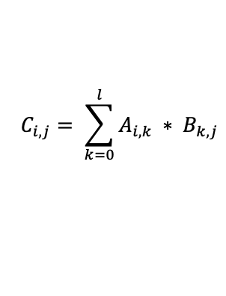
Matrix Multiplication Example
Matrix multiplication for computing each element of matrix C from matrices A and B can be written:
for i in 1:m
for j in 1:n
C[i, j] = 0
for k in 1:k
C[i, j] += A[i, k] * B[k, j]
end
end
end

Slide 9
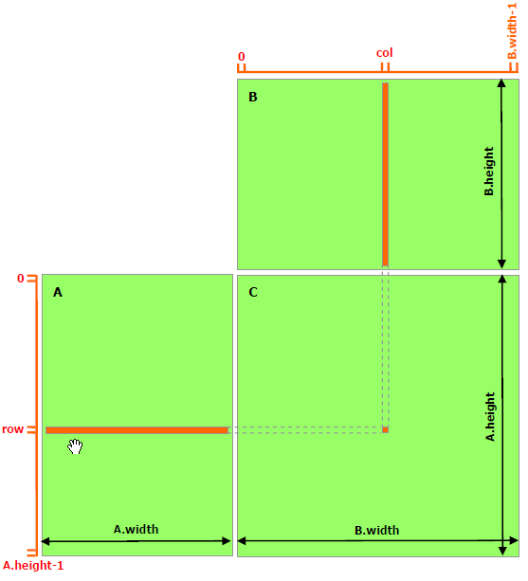

Matrix Multiplication Example (CUDA C++ )
1. __global__ void MatMulKernel(const Matrix, const Matrix, Matrix);
2.
3. void MatMul(const Matrix A, const Matrix B, Matrix C)
4. {
5. Matrix d_A;
6. d_A.width = A.width; d_A.height = A.height;
7. size_t size = A.width * A.height * sizeof(float);
8. cudaMalloc(&d_A.elements, size);
9. cudaMemcpy(d_A.elements, A.elements, size, cudaMemcpyHostToDevice);
10. Matrix d_B;
11. d_B.width = B.width; d_B.height = B.height;
12. size = B.width * B.height * sizeof(float);
13. cudaMalloc(&d_B.elements, size);
14. cudaMemcpy(d_B.elements, B.elements, size, cudaMemcpyHostToDevice);
15.
16. Matrix d_C;
17. d_C.width = C.width; d_C.height = C.height;
18. size = C.width * C.height * sizeof(float);
19. cudaMalloc(&d_C.elements, size);
20.
21. dim3 dimBlock(BLOCK_SIZE, BLOCK_SIZE);
22. dim3 dimGrid(B.width / dimBlock.x, A.height / dimBlock.y);
23. MatMulKernel<<<dimGrid, dimBlock>>>(d_A, d_B, d_C);
24.
25. cudaMemcpy(C.elements, d_C.elements, size,
26. cudaMemcpyDeviceToHost);
27.
28. cudaFree(d_A.elements);
29. cudaFree(d_B.elements);
30. cudaFree(d_C.elements);
31. }
32.
33. __global__ void MatMulKernel(Matrix A, Matrix B, Matrix C)
34. {
35. float Cvalue = 0;
36. int row = blockIdx.y * blockDim.y + threadIdx.y;
37. int col = blockIdx.x * blockDim.x + threadIdx.x;
38. for (int e = 0; e < A.width; ++e)
39. Cvalue += A.elements[row * A.width + e]
40. * B.elements[e * B.width + col];
41. C.elements[row * C.width + col] = Cvalue;
42. }
1024
Matrix size: 1024 x 1024
Block size: 16 x 16
Grid dimension: 64 x 64
16
1024
16
CUDA C++ Programming Guide
https://docs.nvidia.com/cuda/cuda-c-programming-guide/index.html?highlight=matrix%20multiply

Slide 10
CUDA.jl
using CUDA
function MatrixMultiplication!(A,B,C)
row = (blockIdx().x - 1) * blockDim().x + threadIdx().x
col = (blockIdx().y - 1) * blockDim().y + threadIdx().y
sum = zero(eltype(C))
if row <= size(A, 1) && col < size(B, 2)
for i = 1:size(A, 2)
@inbounds sum += A[row, i] * B[i, col]
end
@inbounds C[row, coll] = sum
end
return
end
A = CuArray(1024, 1024)
B = CuArray(1024, 1024)
C = CUDA.zeros(1024, 1024)
threads = (16, 16)
blocks = (64, 64)
@cuda threads=threads blocks=blocks MatrixMultiplication!(A, B, C)

Slide 11
AMDGPU.jl
using AMDGPU
function MatrixMultiplication!(A, B,C)
row = (workgroupIdx()).x - 1) * workgroupDim(). x + workitemIdx().x
col = (workgroupIdx()).y - 1) * workgroupDim(). y + workitemIdx()).y
sum = zero (eltype(C))
if row <= size(A, 1) 8& col <= size(B, 2)
for 1 = 1:size(A, 2)
@inbounds sum += A[row, i] * B[i, col]
end
@inbounds C[row, col] = sum
end
return
end
A = ROCArray(1024, 1024)
B = ROCArray(1024, 1024)
C = AMDGPU.zeros(1024, 1024)
threads = (16, 16)
blocks = (64, 64)
@roc groupsize=threads gridsize=blocks MatrixMultiplication!(A, B, C)

Slide 12
oneAPI.jl and Metal.jl
using oneAPI
function MatrixMultiplication!(A,B,C)
row = get_global_id(0)
col = get_global_id(1)
sum = zero(eltype(C))
if row <= size(A, 1) && col <= size(B, 2)
for i = 1:size(A, 2)
@inbounds sum += A[row, i] * B[i, col]
end
@inbounds C[row, col] = sum
end
return
end
using Metal
function MatrixMultiplication!(A, B,C)
row, col = thread_position_in_grid_2d()
sum = zero(eltype(C))
if row <= size(A, 1) && col <= size(B, 2)
for i = 1:size(A, 2)
@inbounds sum += A[row, i] * B[i, col]
end
@inbounds C[row, col] = sum
end
return
end

Slide 13
GPUs from different vendors are similar
All of them are implicit vector architectures
All of them are focused around kernels => Programs that are launched on the host, and execute asynchronously on the device
KernelAbstractions.jl provides a shallow portability layer for GPUs from AMD, Intel, Apple and NVIDIA.

Slide 14




gets its Power from Extensible Compiler Design
Language design
GPU
AST
xPU back end
IR
Efficient execution
CPU
GPU
Julia: Dynamism and Performance Reconciled by Design Bezanson J. et al (doi:10.1145/3276490)
Effective Extensible Programming: Unleashing Julia on GPUs
Besard T. et al (doi:10.1109/TPDS.2018.2872064)
Notes:
Not as easy at it seams though: builds on well-designed language, and extensible compiler

Slide 15
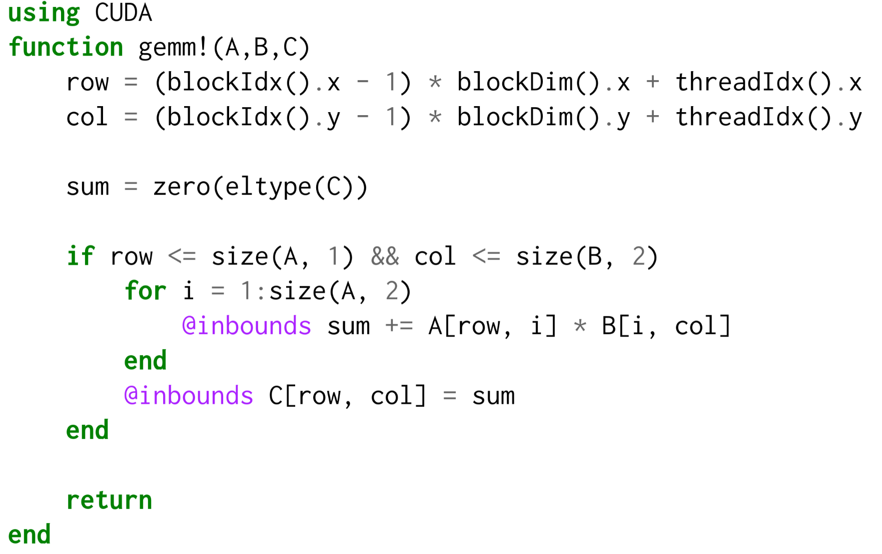
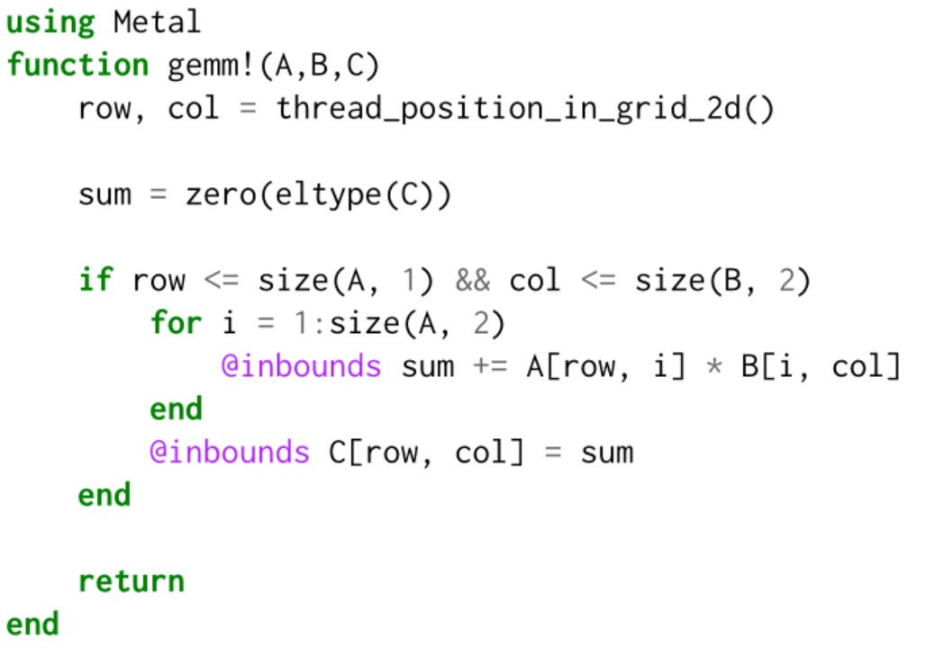
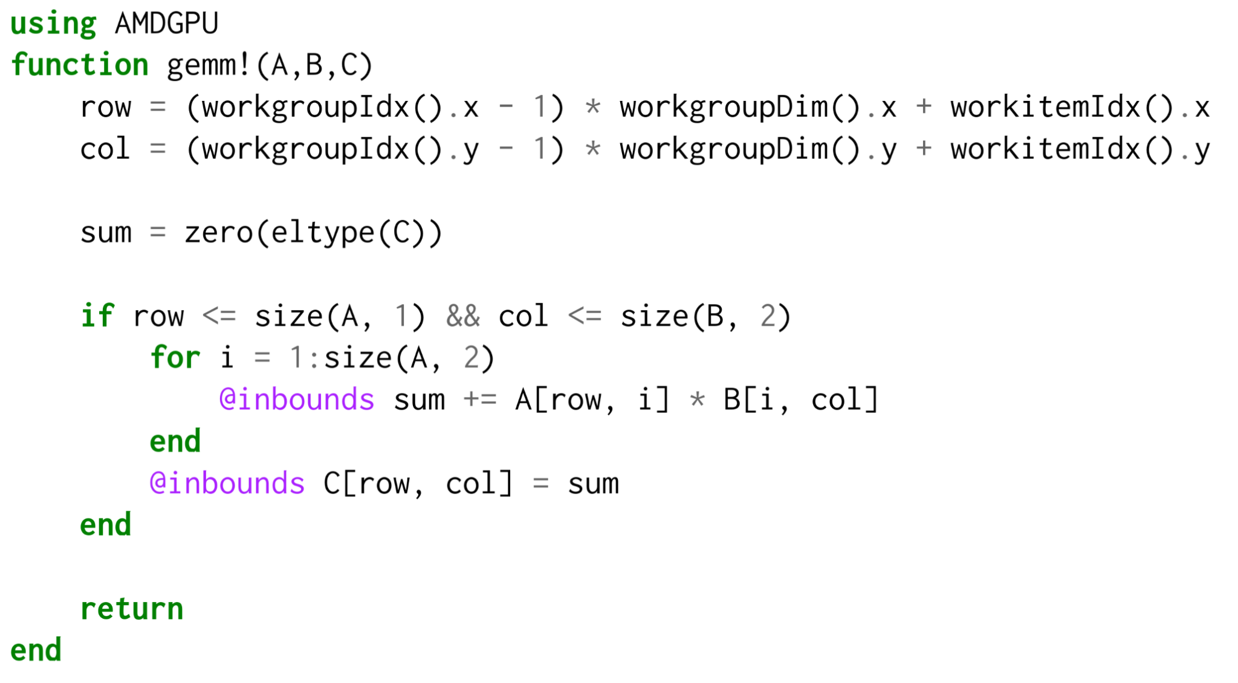
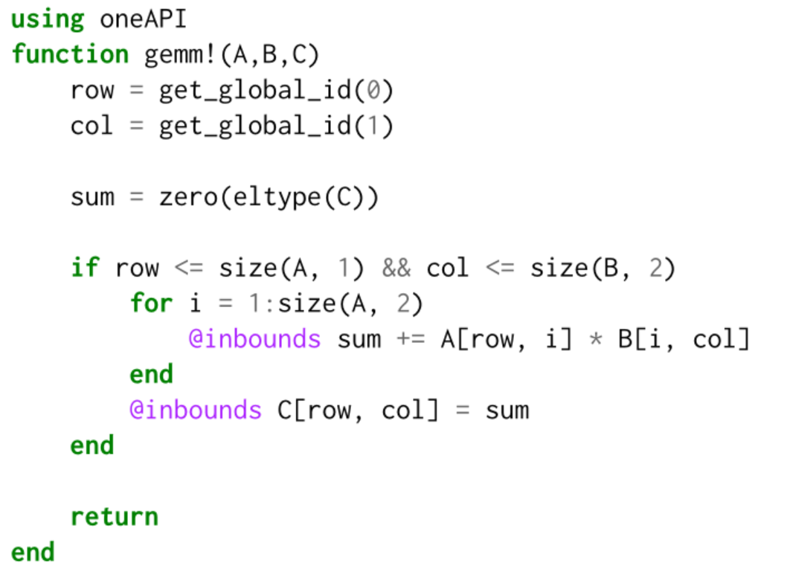
using KernelAbstractions
@kernel function MatrixMultiplication_kernel!(A, B, C)
row, col = @index(Global, NTuple)
sum = zero(eltype(C))
if row <= size(A, 1) && col <= size(B, 2)
for i = 1:size(A, 2)
@inbounds sum += A[row, i] * B[i, col]
end
@inbounds C[row, col] = sum
end
end
Notes:
GPU-centric programming model
SIMT execution model
Multiple GPU backends
Implementation using macros and method overlay tables
GPU backends:
CUDA, AMDGPU, oneAPI, Metal
172 - 188 LOC
CPU execution as a fallback and for debugging

Slide 16
KernelAbstractions.jl
using KernelAbstractions
@kernel function MatrixMultiplication_kernel!(A, B, C)
row, col = @index(Global, NTuple)
sum = zero(eltype(C))
if row <= size(A, 1) && col <= size(B, 2)
for i = 1:size(A, 2)
@inbounds sum += A[row, i] * B[i, col]
end
@inbounds C[row, col] = sum
end
end
A = rand!(allocate(Backend, Type, 1024, 1024))
B = rand!(allocate(Backend, Type, 1024, 1024))
C = KernelAbstractions.zeros(Backend, Type, 1024, 1024)
workgroupsize = (16, 16)
kernel! = MatrixMultiplication_kernel!(Backend, workgroupsize)
kernel!(A, B, C, ndrange=(size(C)))
KernelAbstractions.synchronize(Backend)

Slide 17
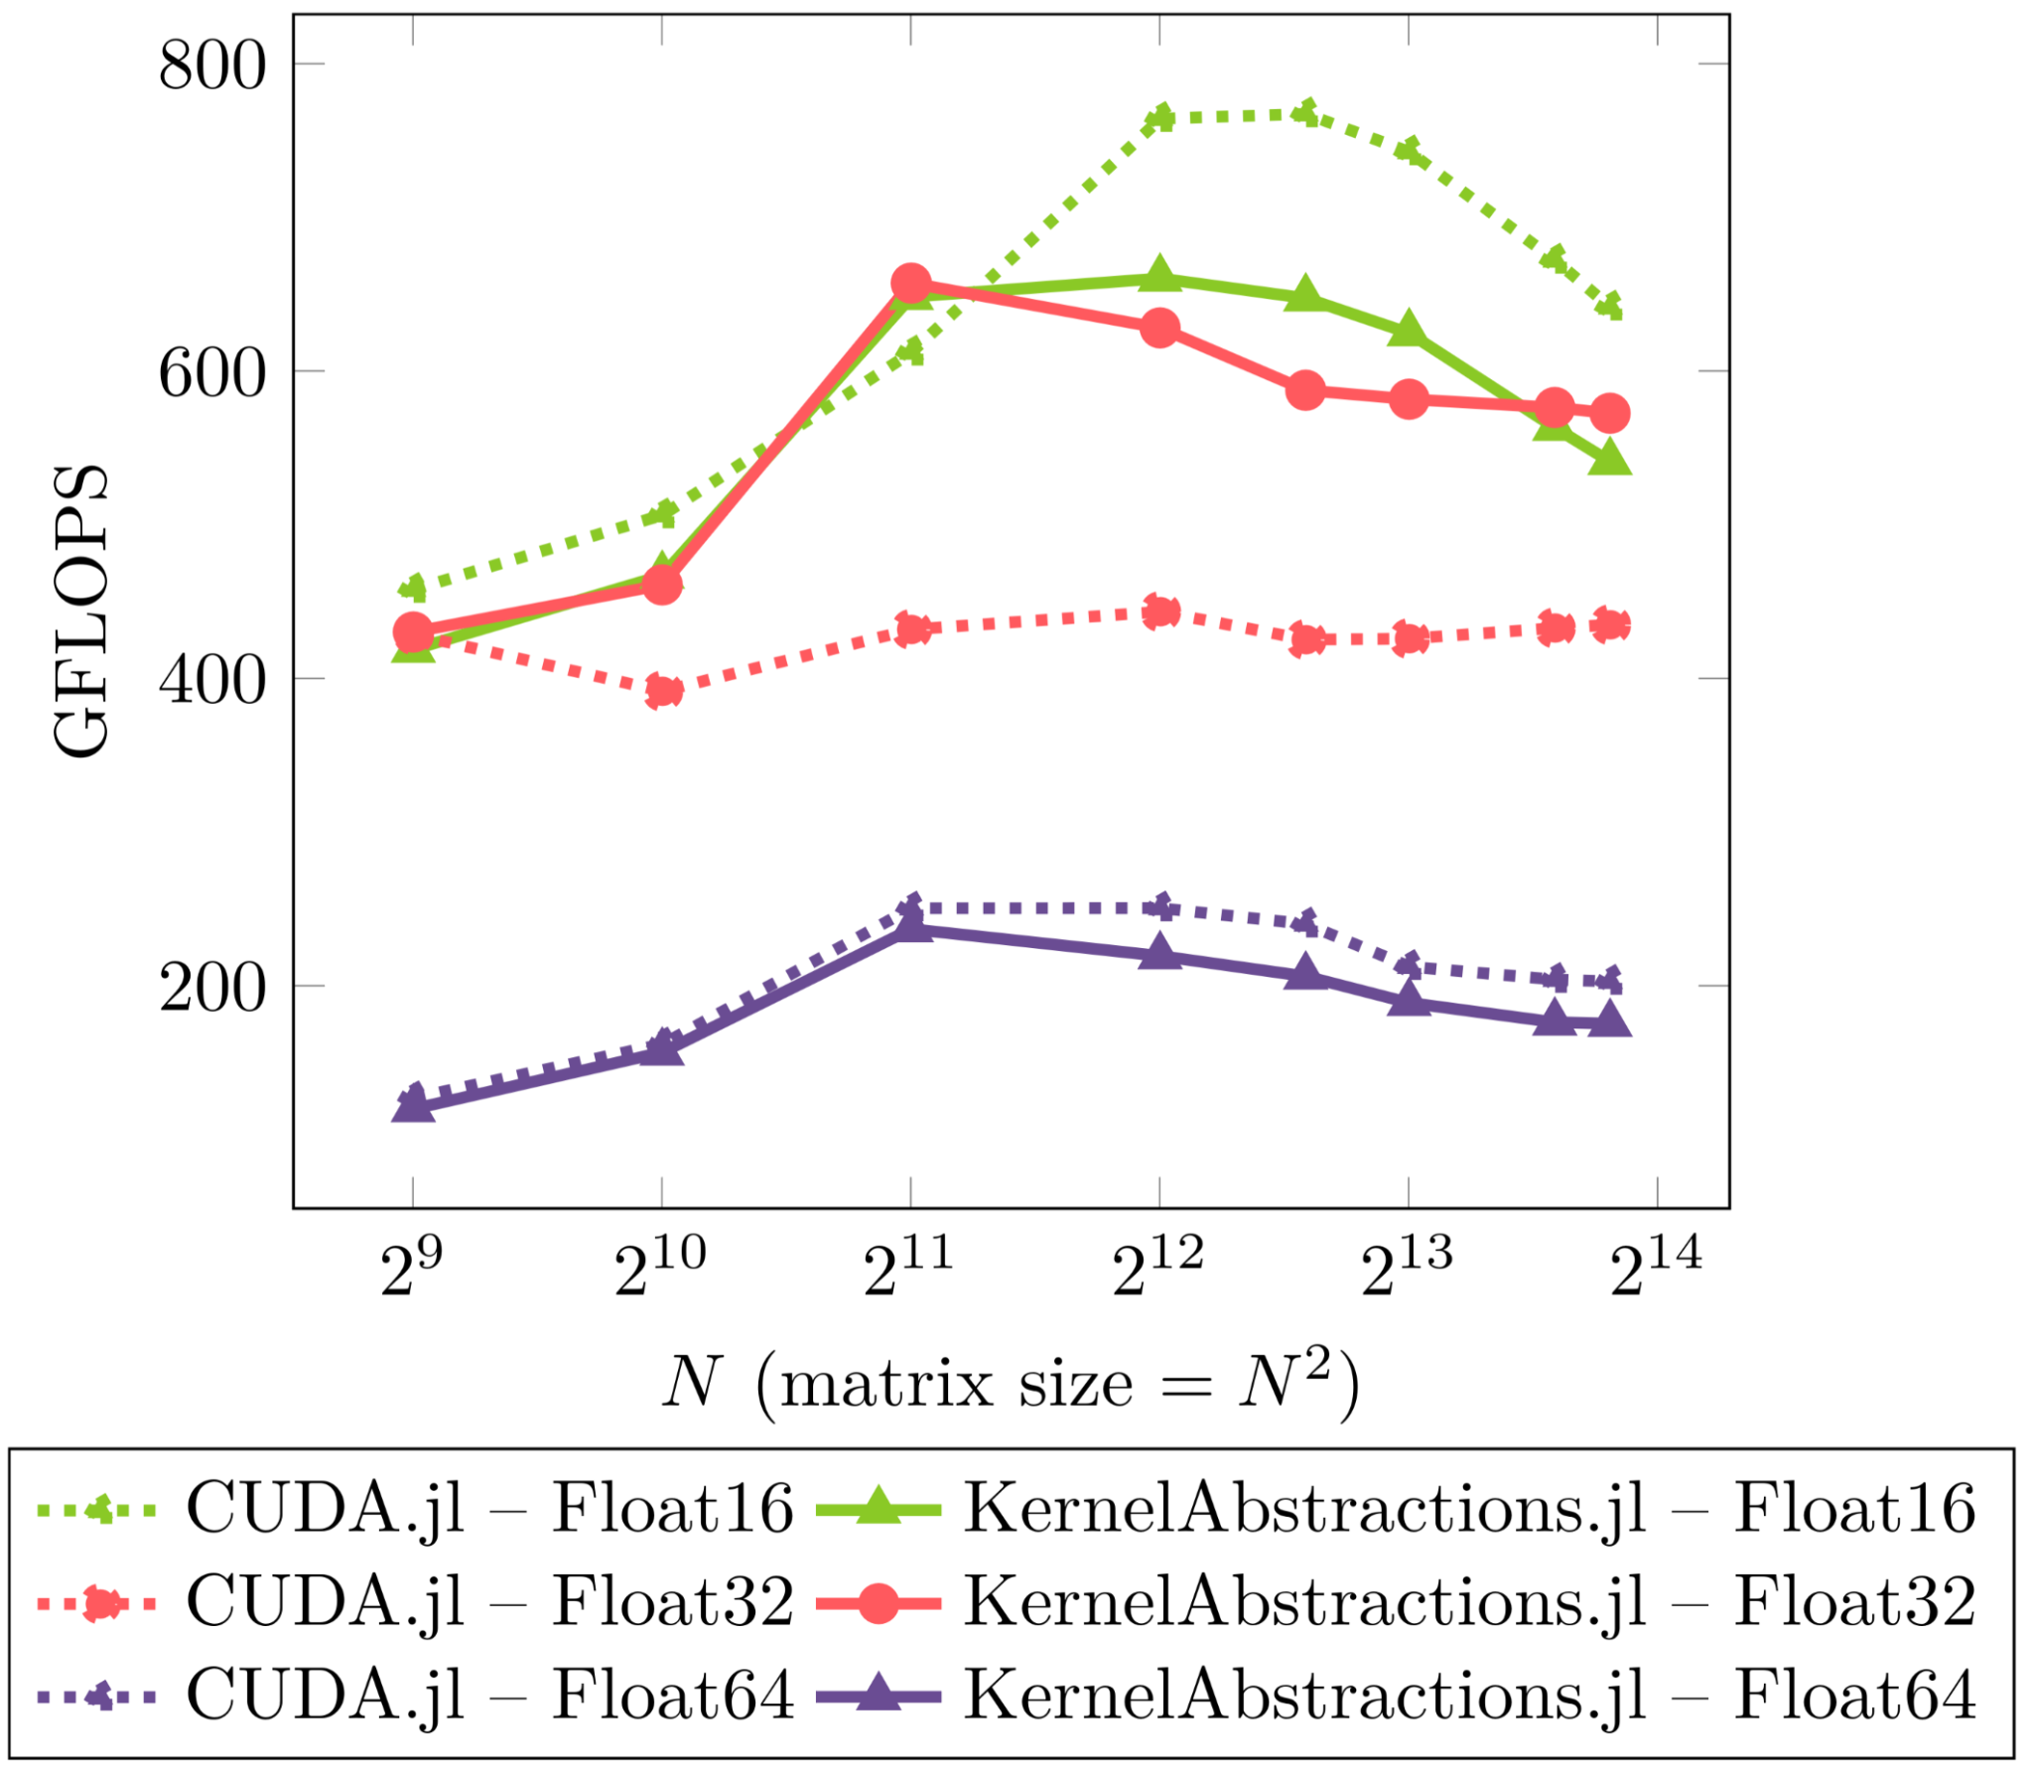
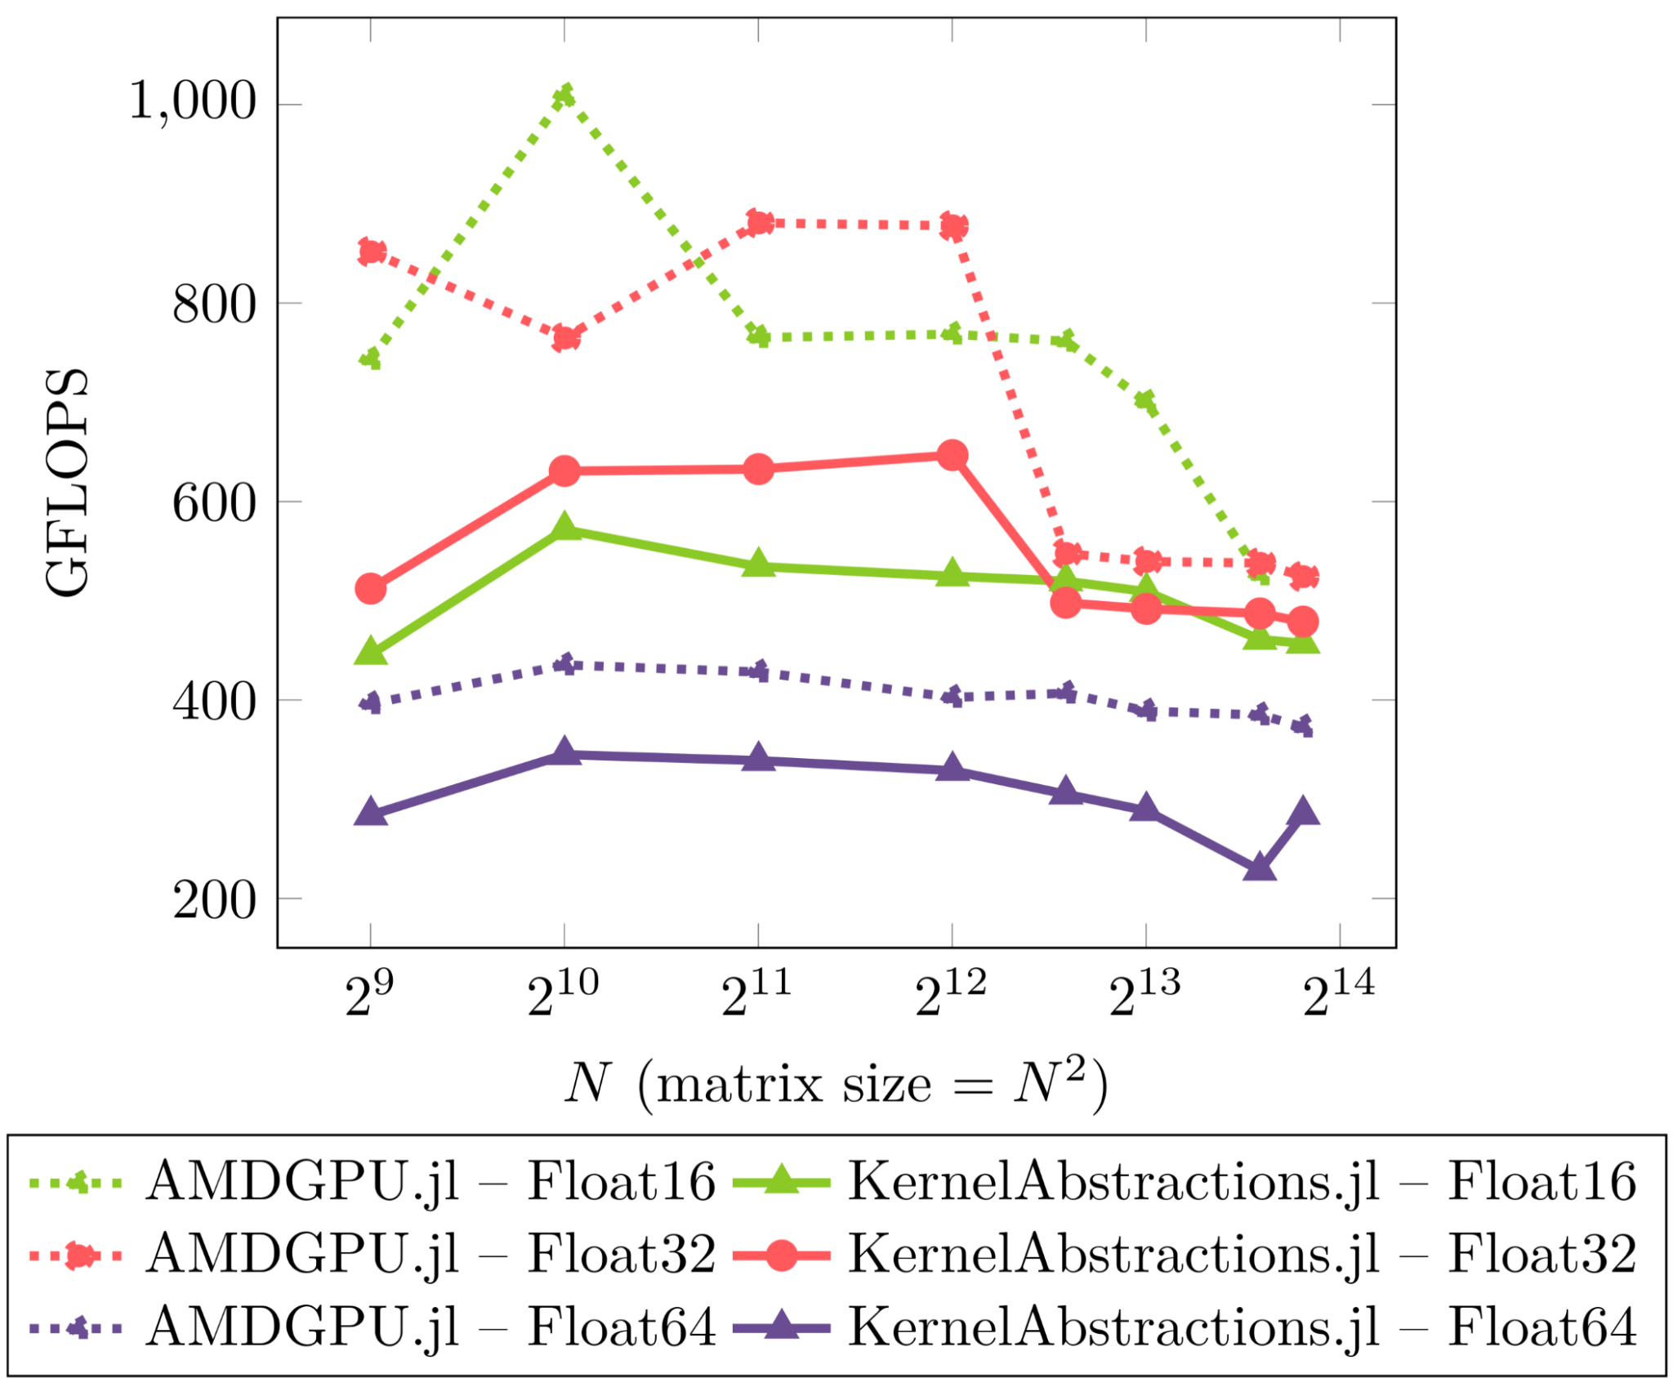
Performance — Microbenchmark (Naive GEMM)

Slide 18
Kernel language — @kernel
KernelAbstractions defines a language valid within @kernel definitions
@Const: Declares an argument to not be aliased or written to
@index: Which kernel element are we operating upon?
@localmem: Allocate local (shared) memory
@synchronize: Synchronize warps/wavefronts
@uniform: Declares a variable to be unchanging across lanes
@private: Allocate private memory for a lane
@print: Unified printing of device-side data

Slide 19
Kernel language: Indexing
Indexing Method:
@index(Global, Kind): Global index for accessing input arguments
@index(Group, Kind): Which work-group does the lane belong to?
@index(Local, Kind): Which item inside a work-group is this lane?
Indexing Kind:
@index(Locale, Cartesian): Index as a CartesianIndex
@index(Locale, NTuple): Index as a tuple
@index(Locale, Linear): Index as a scalar

Slide 20
Memory copy with KernelAbstractions
@kernel function lmem_copy_kernel!(output, @Const(input))
I, J= @index(Global, NTuple) # Global index of thread
i, j = @index(Local, NTuple) # Local index of thread
N = @uniform @groupsize()[1] # blockDim.x
M = @uniform @groupsize()[2] # blockDim.y
tile = @localmem eltype(output) (N, M) # Allocate local (shared) memory
@inbounds tile[i, j] = input[I, J]
@synchronize
@inbounds output[I, J] = tile[i, j]
end

Slide 21
Kernel instantiation
Instantiate kernel for compute device
Decide between static or dynamic workgroupsize
Decide between static or dynamic ndrange
Call kernel with arguments and dynamic parameters.
const lmem_copy! = lmem_copy_kernel!(CUDADevice(), (32, 32))
lmem_copy!(output, input, ndrange=size(input))
KernelAbstractions.synchronize(CUDADevice())
device = CUDADevice()
workgroupsize = (32, 32) # Static
ndrange = size(input) # Dynamic
dependencies = nothing
KernelAbstractions.jl
Churavy V., et. al. (10.5281/zenodo.12584010 )

Slide 22


